Slide 1
Random Forest Classifier for Predicting Coronary Illness
Guided By
Mrs. M. MATHUMATHI (AP,CSE)
Team members
- Shri Vishnu P
- Somasundaram
- Sakthivel

Slide 2
Contents
Abstract
Introduction
Literature Survey
Existing System
Proposed System
System Requirements
Operations
Conclusion

Slide 3
Abstract
Heart disorders AKA cardiovascular diseases (CVDs), have become the most hazardous diseases and leading cause of death across globe in recent years
It is due to a change in blood pressure, sugar, pulse rate which results in heart failure, aneurysms, peripheral artery disease, heart attacks, strokes, and sudden cardiac arrest
It can be diagnosed using various medical tests
GOAL - To diagnose various cardiac illnesses and to take necessary steps to prevent it at a reasonable charge as early as possible
It uses machine learning techniques to predict Coronary Artery Disease where machine learning methods like Random Forest and Decision Tree was employed.

Slide 4
Introduction
People's behaviour and lifestyles are changing as a result of advances in science and technology
In XXI century, deskbound lifestyle and the improper diet of people are the most common cause for cardiovascular disease
Kaggle notebook was used for carrying out a classification strategy with the help of Decision Tree and Random Forest as the heart disease dataset processing, resulting in accurate and precise findings in evaluating heart disease

Slide 5
Literature Survey
S.no | Author | Project Title | Description
1 | A. S. Abdullah and R. R. Rajalaxmi | A data mining model for predicting the coronary heart disease using random forest classifier | Data mining model has been developed using Random Forest classifier to improve the prediction accuracy and to investigate various events related to CHD.
2 | Mamatha Alex P and Shaicy P. Shaji | Prediction and Diagnosis of Heart Disease Patients using Data Mining Technique | `Data mining' technique in which attributes are fed in to SVM, Random forest, KNN, and ANN classification Algorithms for the prediction of heart diseases.
3 | Sarah Saud Alotaibi, Yasmeen Ahmed Almajid | Automated prediction of Coronary Artery Disease using Random Forest and Naïve Bayes | the study focused on developing predictive model for the diagnosis of CAD. The model was developed using computational machine learning techniques that incorporate Random Forest (RF), and Naïve Bayes (NB) techniques.

Slide 6
Existing System
The patient provides the input details for the system
Then, the cardiac illness is assessed using machine learning algorithms based on the user inputs and the generated findings are compared to those of current models in the same domain and found to be superior
Patterns are discovered using NN, DT, Support Vector Machines SVM, and Naive Bayes on data from heart disease patients obtained at the UCI laboratory
With these algorithms, the performance and accuracy of the outcomes are compared. In comparison to other current methods, the suggested hybrid method produces results of 87 percent for F-measure

Slide 7
Limitation of Existing System
Prediction of cardiovascular disease results is not accurate
Data mining techniques does not help to provide effective decision making
Does not perform very well when the data set has more noise

Slide 8
Proposed System
Python and pandas operations are used to classify heart disease using data from the UCI repository after reviewing the findings from existing approaches
It offers a simple visual representation of the dataset, working environment, and predictive analytics development
The machine learning process begins with data pre-processing, then moves on to feature selection based on data cleansing, categorization, and evaluation of modelling performance
To improve the accuracy of the outcome, a random forest technique is applied

Slide 9
Advantage of Proposed System
Increased accuracy for effective heart disease diagnosis
Handles roughest(enormous) amount of data using random forest algorithm and feature selection
Reduce the time complexity of doctors
Cost effective for patients

Slide 10
System Requirements
Hardware Requirements
Software Requirements
System Processor - Intel core 2
Hard Disk - 40 GB
Monitor - 15 VGA Colour
Mouse - Logitech
Ram - 4GB
Operating system: > Windows XP/7
Coding Language - Python
Platform - Kaggle Notebook
Database - UCI Machine Learning Repository

Slide 11
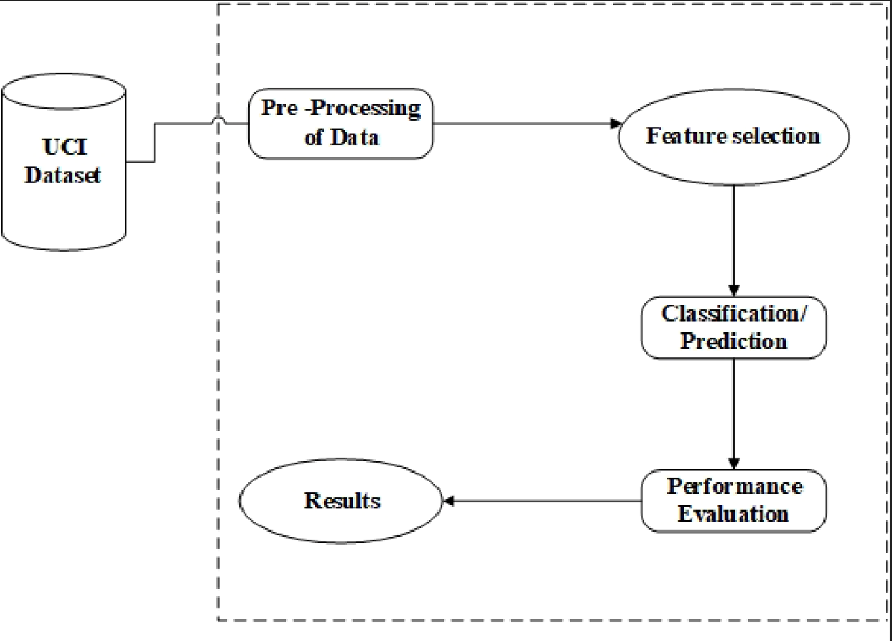
Architecture of the model

Slide 12

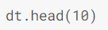
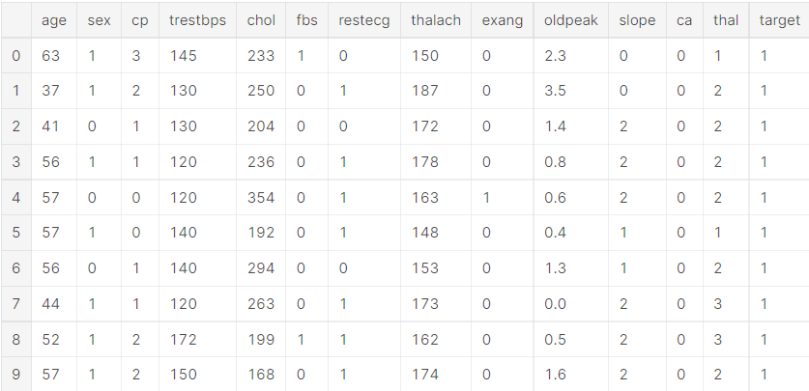
Operations
load the data
Display the data
Output

Slide 13
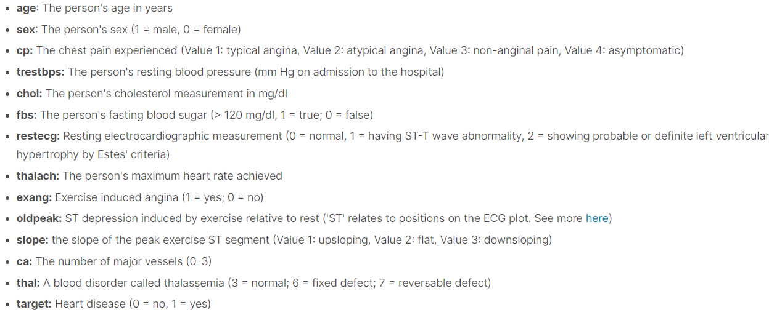
Abbreviation of row headings

Slide 14

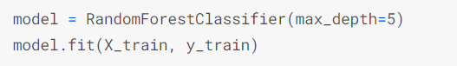
The Model
Creation of model
Output

Slide 15
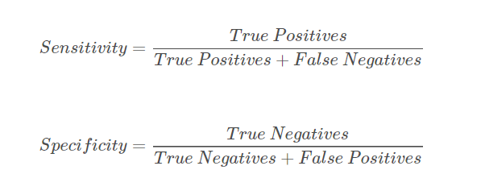
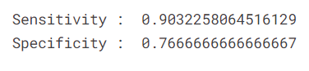
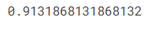
Calculations
sensitivity and specificity
Accuracy

Slide 16
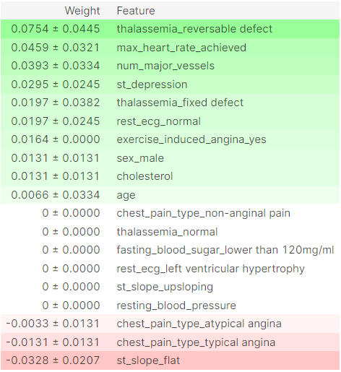
Explanation
Permutation importance is the first tool for understanding a machine-learning model, and involves shuffling individual variables in the validation data (after a model has been fit), and seeing the effect on accuracy.

Slide 17
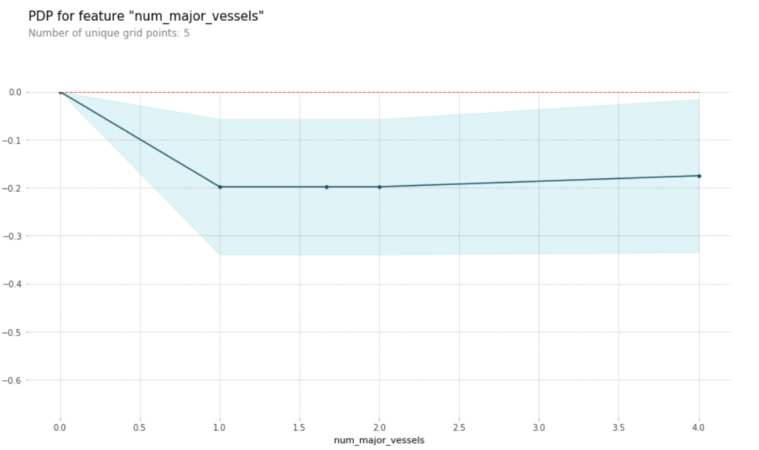
Partial Dependence Plot

Slide 18
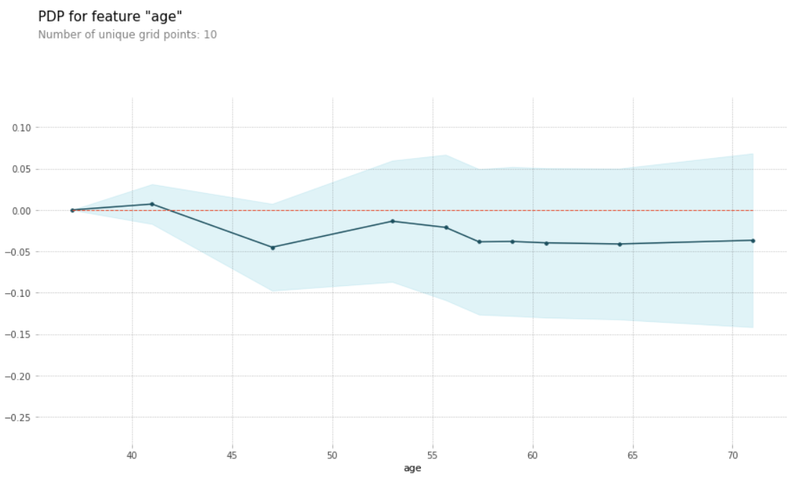

Slide 19
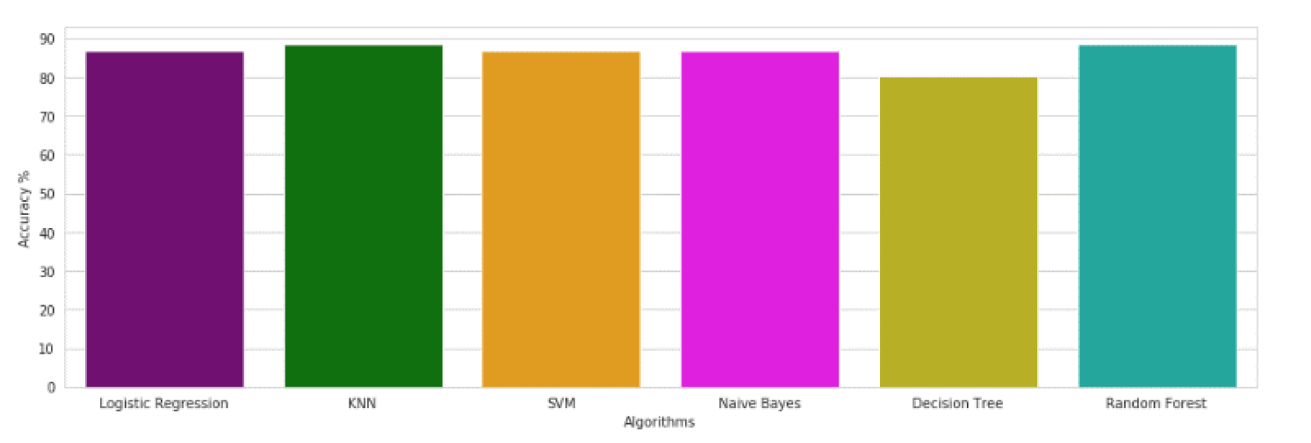
Performance comparison with various models

Slide 20
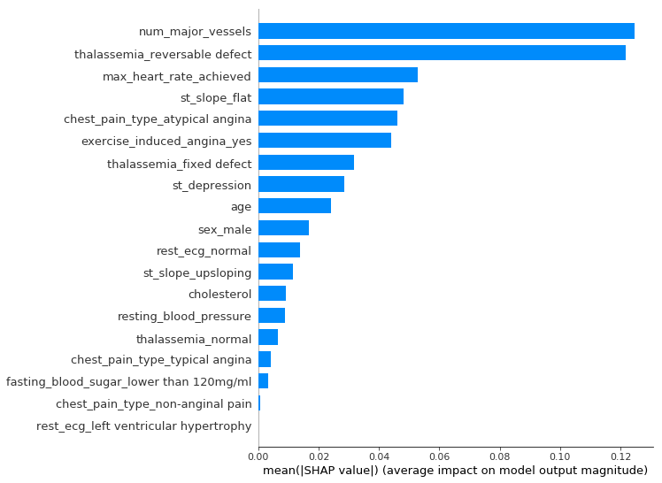
Prediction

Slide 21
Conclusion
A machine learning-based strategy for predicting heart illness was proposed and the findings demonstrated a high accuracy threshold for offering a superior estimation result
A new Random Forest classification was offered to handle the problem of rate prediction without equipment, as well as a way to estimate heart rate and condition
The sensitivity value 90.3%. specificity value 76.7, and accuracy value of 91.3 for prediction was estimated
ML Techniques are used to extract information from the above input

Slide 22
Thank You!

